Slide 1
Graph Neural Network (GNN)
for PM2.5 Concentration Prediction
Wang Shuo

Slide 2
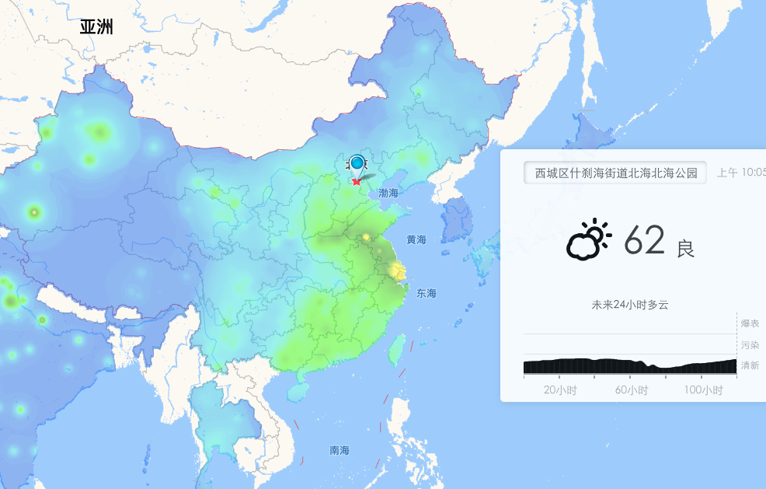
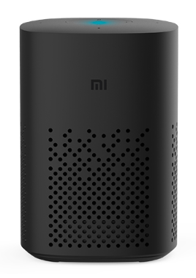
彩云天气
“小爱同学，请问北京未来几天的空气质量如何”
http://caiyunapp.com/map/#116.3883,39.9289

Slide 3
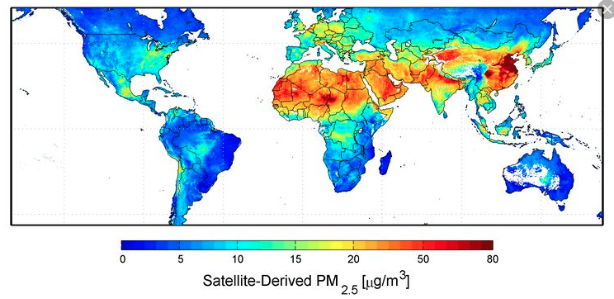
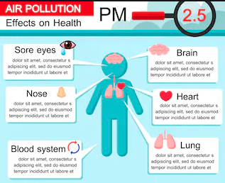
Background
PM 2.5
Fine Particulate Matter (PM2.5) consists of particles with aerodynamic diameters less than 2.5um.
one type of Air Pollutants (PM10, SO2, O3, NO, etc.)
Long-term exposure to polluted air can have permanent health effects such as: Accelerated aging of the lungs. Loss of lung capacity and decreased lung function.
global issue
Challenges
long-term spatio-temporal correlation
Interpretability
Incorporate with domain knowledge of meteorology and environmental science

Slide 4
PM2.5 Data
Time-Lapse Video Shows Smog Enveloping Beijing, https://www.youtube.com/watch?v=BPzzlBVtXH0

Slide 5
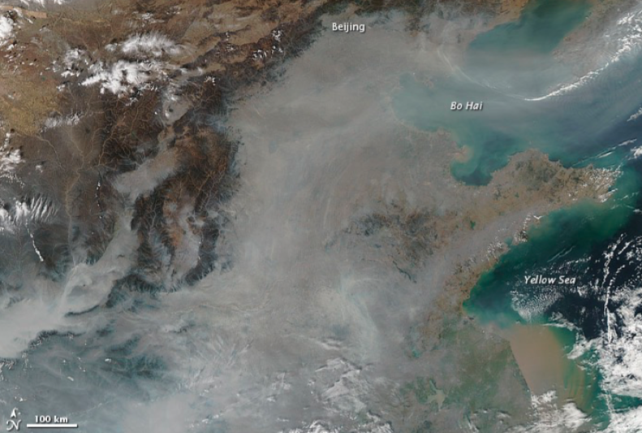
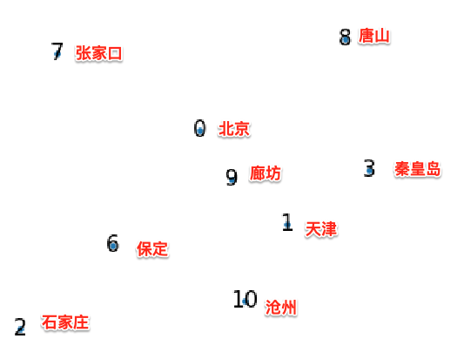
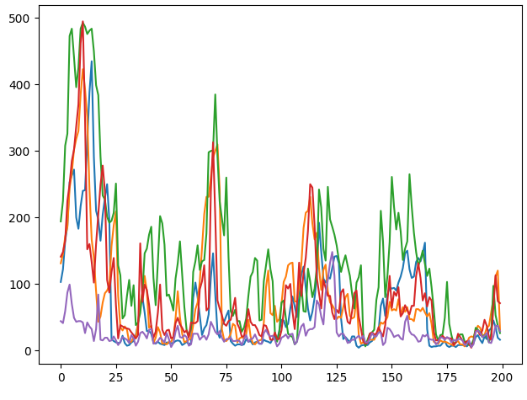
PM2.5 Data
Spatio-Temporal Correlation between Air Quality Monitoring Stations.
Satellite Image from NASA
Monitoring Stations Distribution（122°E-102°E and 28°N-42°N）
Jing-jin-ji Area City Distribution
PM2.5 point-wise time series

Slide 6
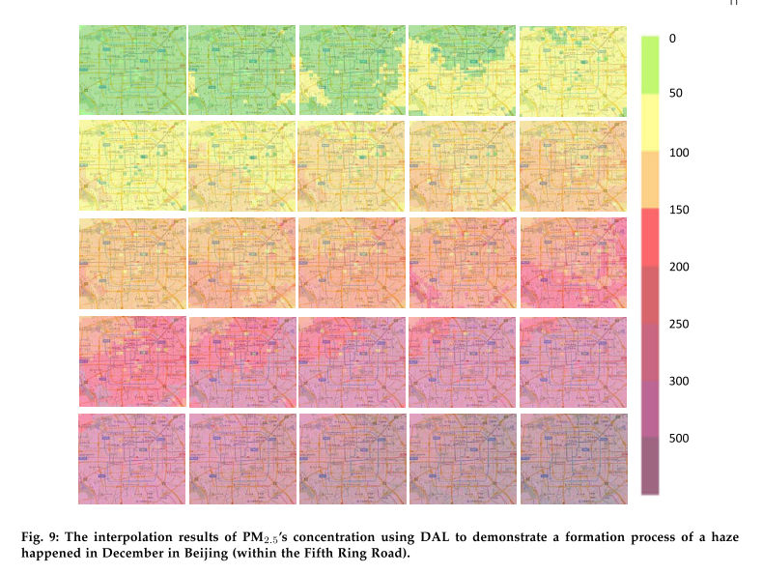
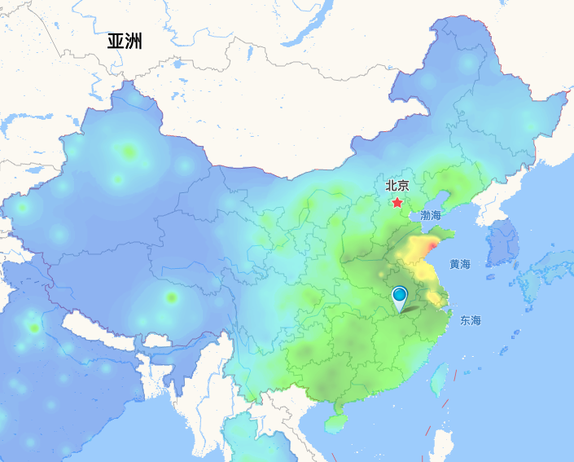
Related Works
Grid-based Method
Y. Liang, S. Ke, J. Zhang, X. Yi, and Y. Zheng, “Geoman: Multi-level attention networks for geo-sensory time series prediction,” in IJCAI International Joint Conference on Artificial Intelligence, 2018, vol. 2018-July, pp. 3428–3434.
Z. Qi, T. Wang, G. Song, W. Hu, X. Li, and Z. Zhang, “Deep Air Learning: Interpolation, Prediction, and Feature Analysis of Fine-Grained Air Quality,” IEEE Trans. Knowl. Data Eng., vol. 30, no. 12, pp. 2285–2297, 2018.
drawbacks
Introduce in introduce the inaccurate interpolation (idw) data
fixed resolution
unable to model "long"-term spatio-temporal correlation
Air quality monitoring station distribution of China
Notes:
city level

Slide 7
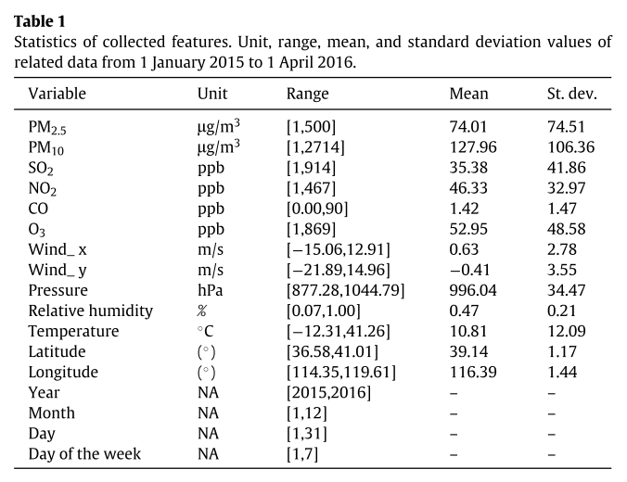
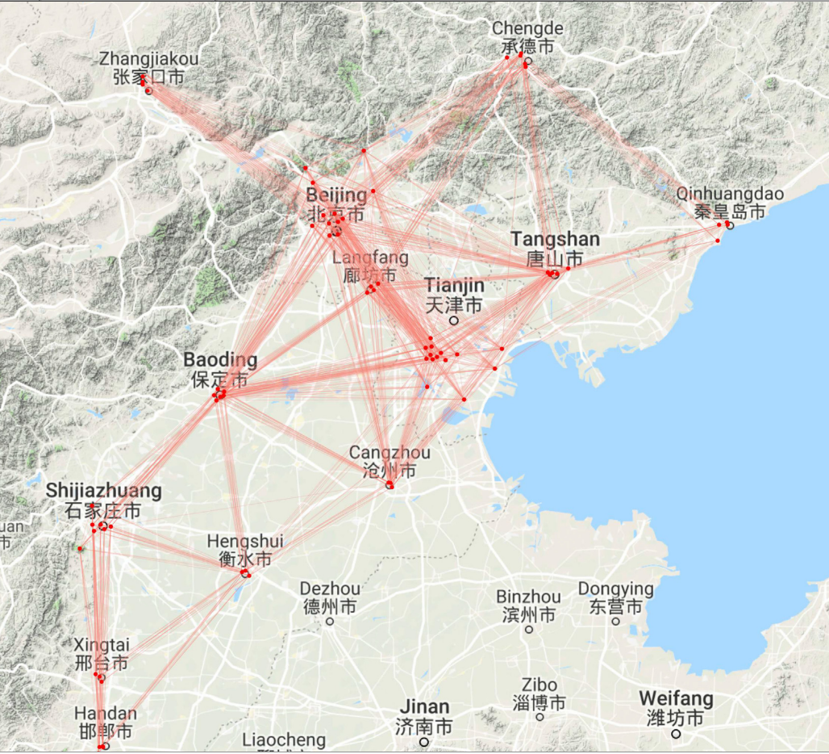
Related Works
Graph-based Method
Y. Lin et al., “Exploiting spatiotemporal patterns for accurate air quality forecasting using deep learning,” GIS Proc. ACM Int. Symp. Adv. Geogr. Inf. Syst., pp. 359–368, 2018.
Y. Qi, Q. Li, H. Karimian, and D. Liu, “A hybrid model for spatiotemporal forecasting of PM 2.5 based on graph convolutional neural network and long short-term memory,” Sci. Total Environ., vol. 664, pp. 1–10, 2019.
drawbacks
small spatio-temporal scale
lack of enough domain knowledge
Notes:
city level
只是用了地面站数据。

Slide 8
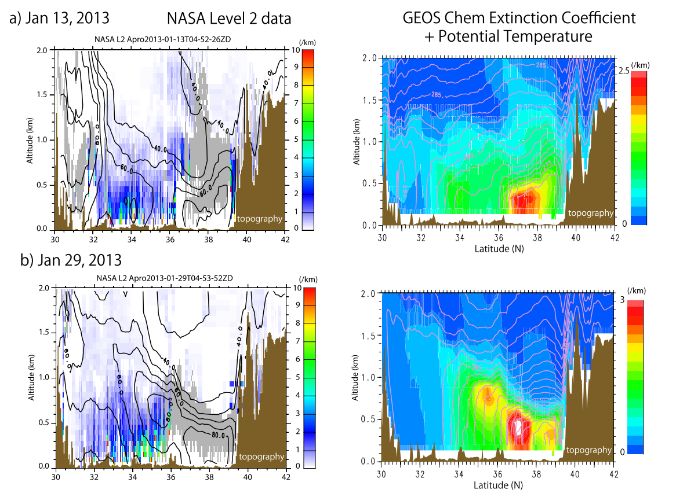
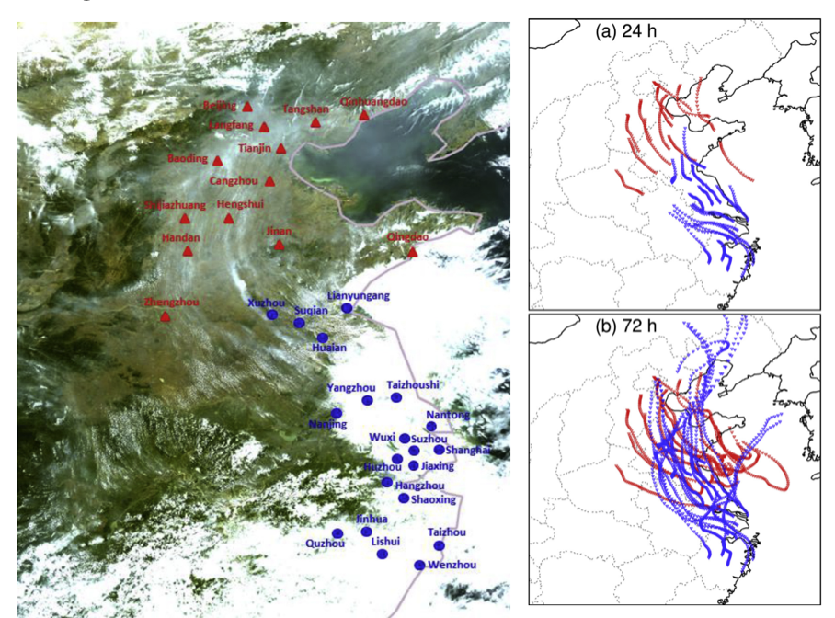
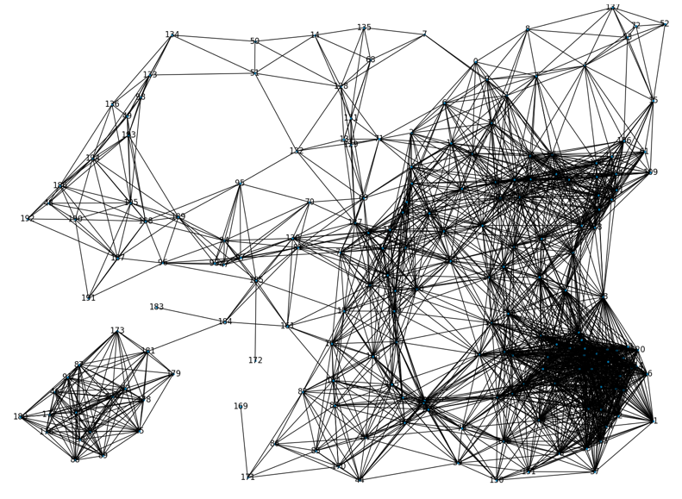
Graph Construction
"Most aerosol pollutants concentrated in boundary layer below 1500 m vertical height, in particular, the vertical heights of 100-800 m above the ground are peaks of the aerosol pollutants." [1]
PM2.5 can be transported about 1000+km and 72 hours by wind. [2]
PM2.5 vertical distribution
Monitoring Stations Distribution
Construct Graph encoded the spatial correlation between stations
[1] I. Uno, N. Sugimoto, A. Shimizu, K. Yumimoto, Y. Hara, and Z. Wang, “Record heavy PM2.5 air pollution over China in January 2013: Vertical and horizontal dimensions,” Sci. Online Lett. Atmos., vol. 10, no. 1, pp. 136–140, 2014.
[2] J. Hu, Y. Wang, Q. Ying, and H. Zhang, “Spatial and temporal variability of PM 2.5 and PM 10 over the North China Plain and the Yangtze River Delta, China,” Atmos. Environ., vol. 95, pp. 598–609, 2014.

Slide 9
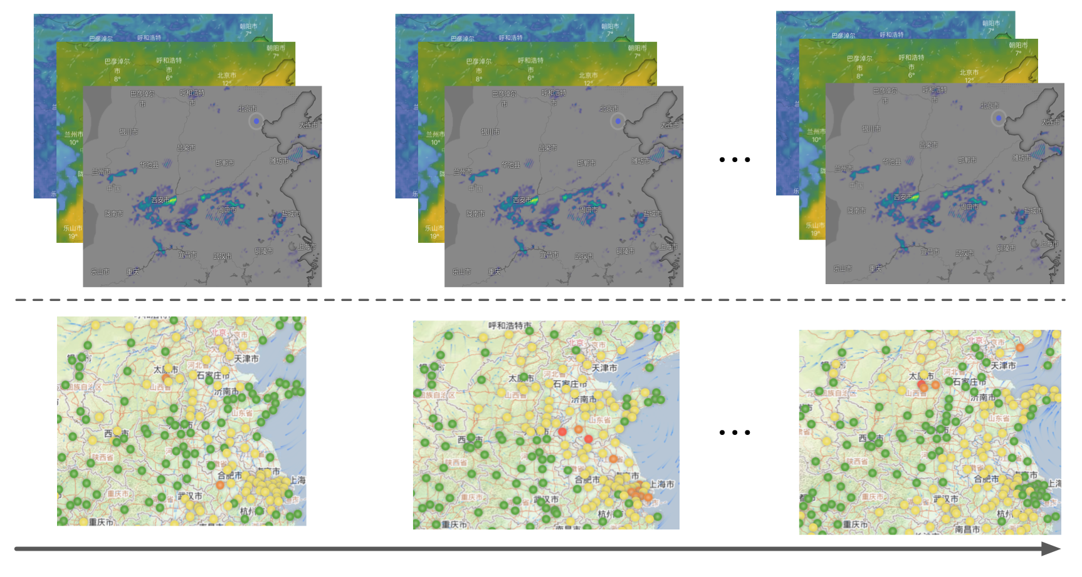
Problem Statement
meteorologicaldata
?
?
pm25 data
（Past）
T
T+1
...
T+n
（Future）

Slide 10
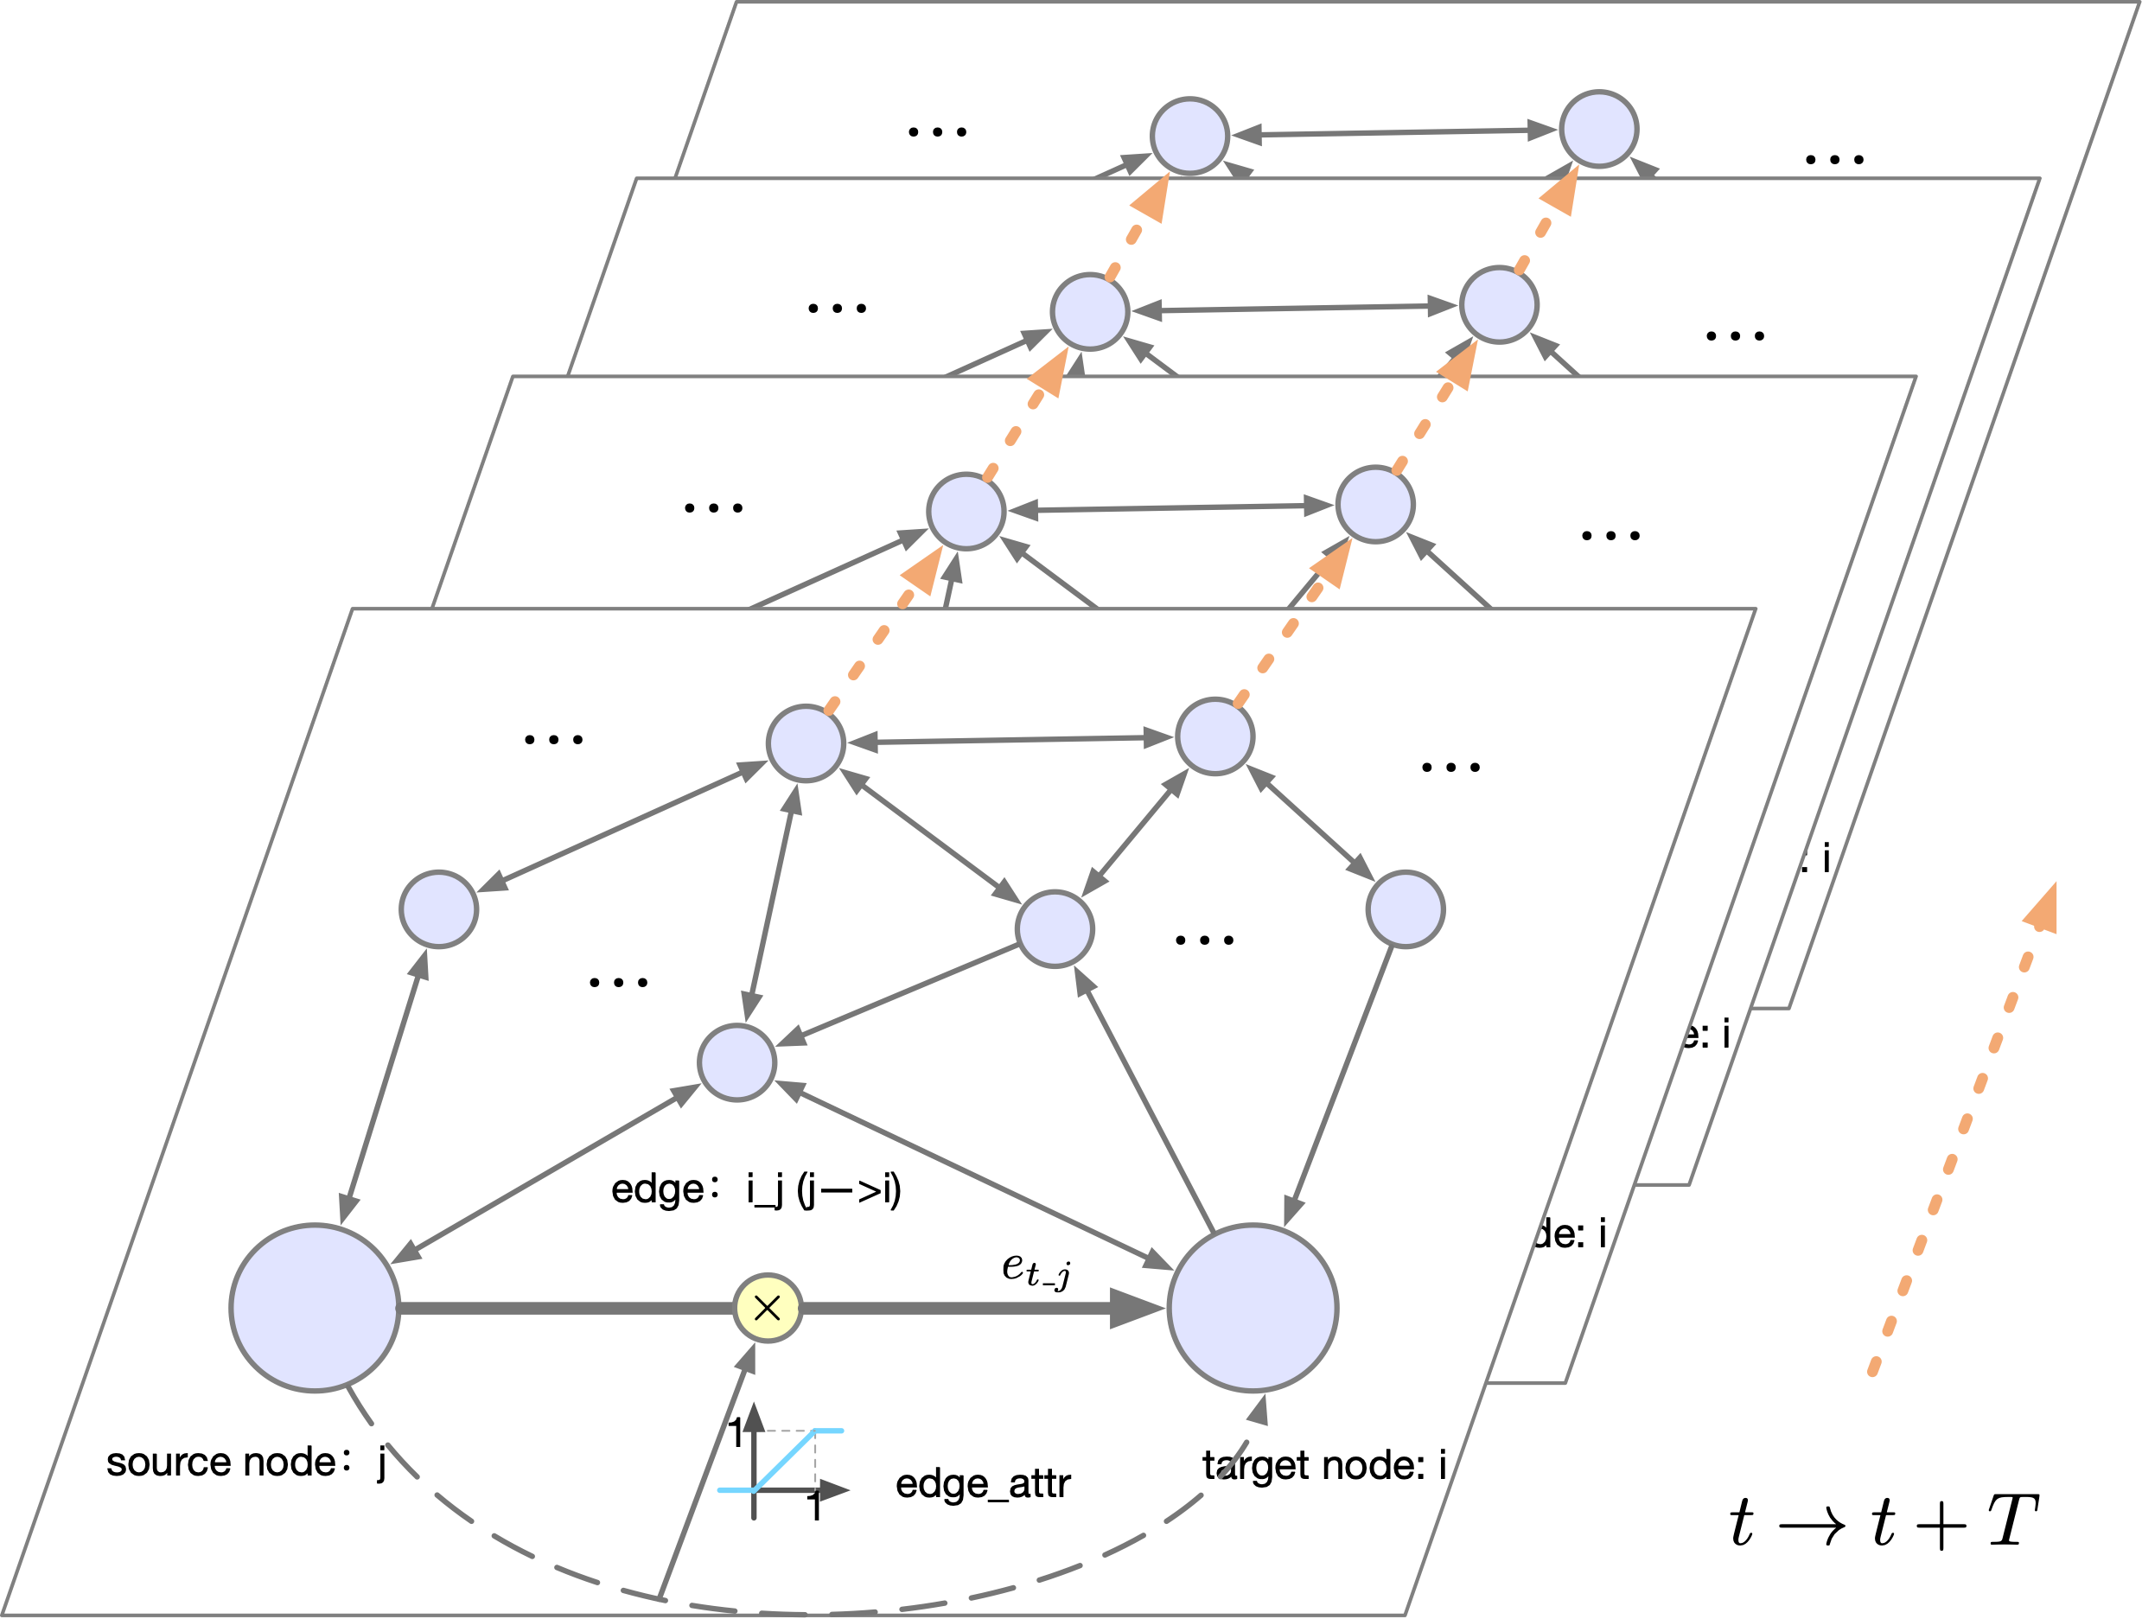
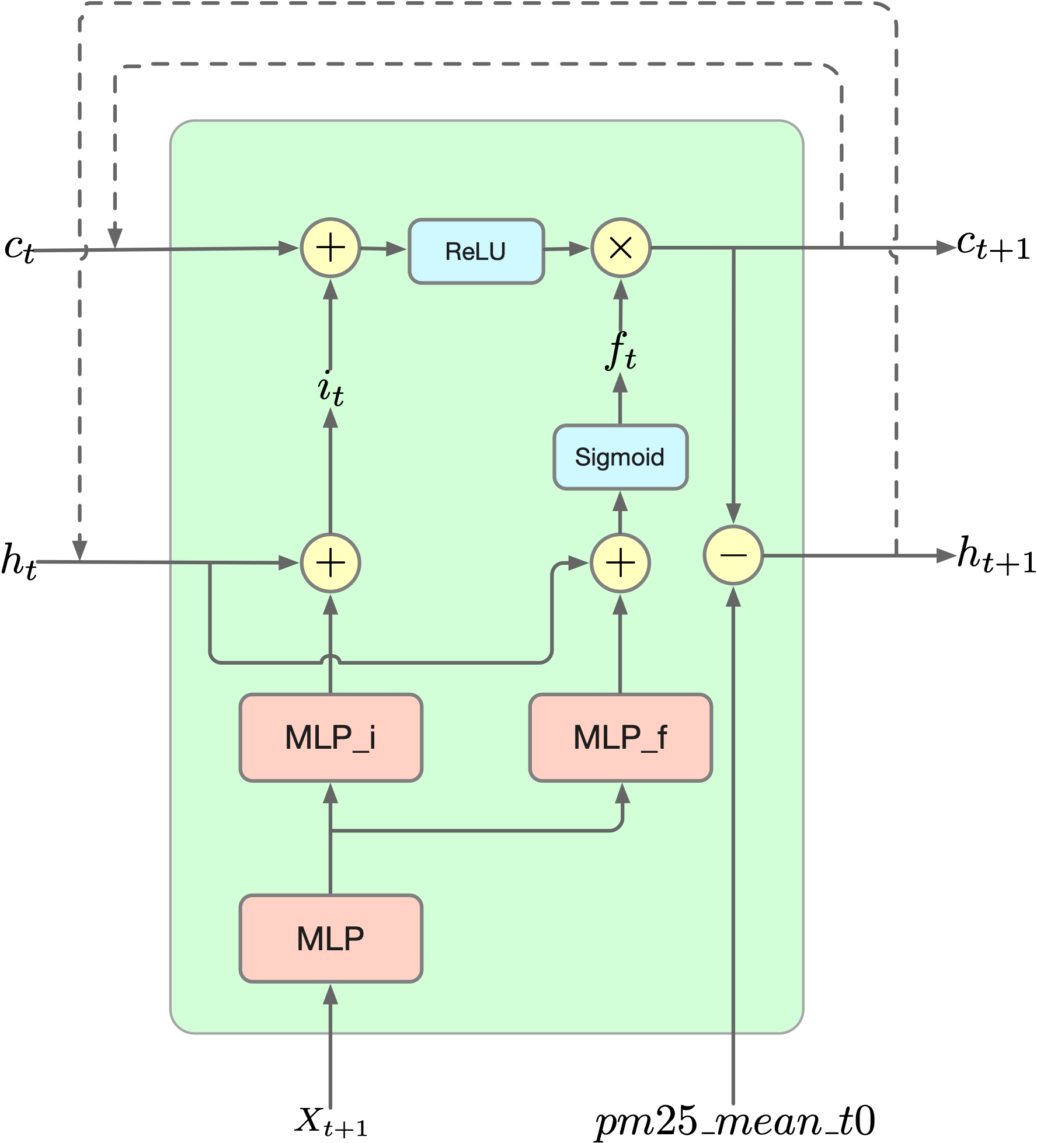
Model
Graph Neural Network (GNN)
customized Long Short-Term Memory (LSTM)
pollutants' horizontal transmission influenced by winds
pollutants' accumulation, vertical diffusion and deposition

Slide 11
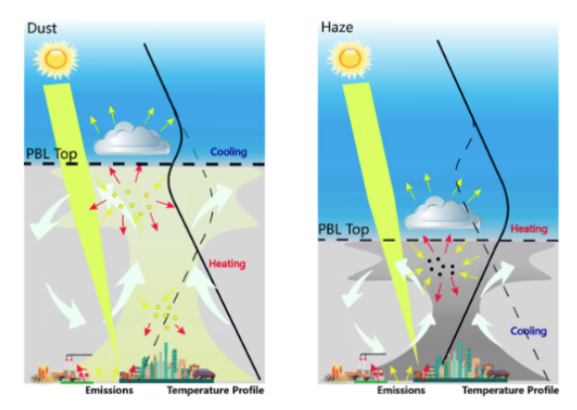
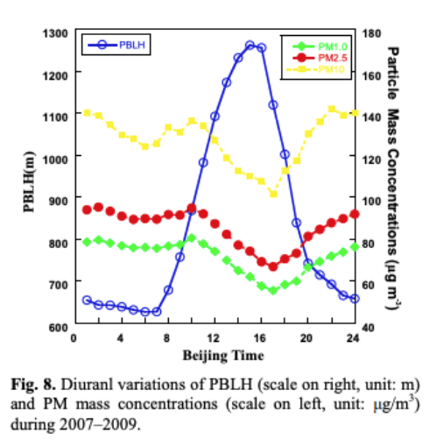
Model
Node feature
950 hPa wind (u & v)
2m Temperature
Relative humidity
Total Precipitation
Boundary layer height
Edge feature
Wind Speed
Wind Direction
Station Distance
Station Direction
PM2.5 and Boundary Layer Height
[3] F. Davies, D. R. Middleton, and K. E. Bozier, “Urban air pollution modelling and measurements of boundary layer height,” Atmos. Environ., vol. 41, no. 19, pp. 4040–4049, Jun. 2007.
[4] T. Petäjä et al., “Enhanced air pollution via aerosol-boundary layer feedback in China,” Sci. Rep., vol. 6, Jan. 2016.

Slide 12
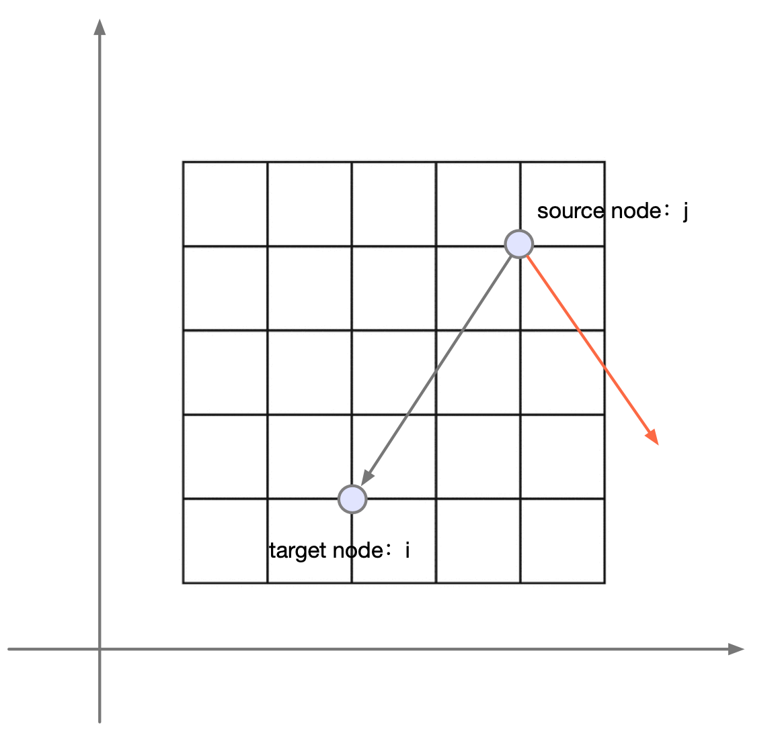
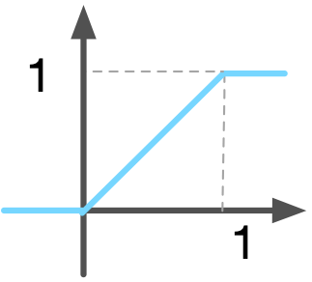
Model
Node feature
950 hPa wind (u & v)
2m Temperature
Relative humidity
Total Precipitation
Boundary layer height
Edge feature
Wind Speed
Wind Direction
Station Distance
Station Direction
GNN (neighborhood aggregation + message passing)

Slide 13
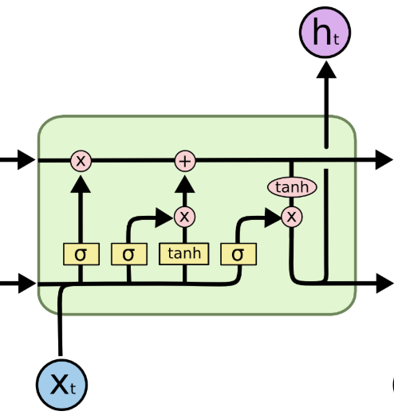
Model
Node model based on LSTM

Slide 14
Experiments
 | GRU with domain knowledge |  |  |  |  | Proposed Model
 | MAE | RMSE | CSI | POD | FAR | MAE | RMSE | CSI | POD | FAR
Dataset 1 | 37.35±0.2 | 48.17±0.16 | 48.14±0.8 | 59.46±1.8 | 20.82±1.16 | 35.47±0.04 | 45.58±0.03 | 57.02±0.1 | 84.34±0.8 | 19.44±1.5
Dataset 2 | 29.47±0.34 | 39.62±0.33 | 47.11±0.9 | 60.98±1.5 | 26.17±0.6 | 30.04±0.09 | 39.88±0.09 | 46.45±0.7 | 64.13±1.5 | 24.34±1.2
Dataset 3 | 24.63±0.2 | 32.02±0.24 | 29.4±0.4 | 53.7±2 | 57±0.68 | 23.14±0.03 | 30.48±0.03 | 27.7±0.9 | 41.12±3.5 | 45.19±0.4
Study Area: 122°E-102°E and 28°N-42°N
Dataset1
Train: 2016.10.1 - 2016.12.31
Test: 2017.1.1 - 2017.1.31
Dataset2
Train: 2016.11.1 - 2017.1.31
Test: 2017.2.1 - 2017.2.28
Dataset3
Train: 2016.12.1 - 2017.2.28
Test: 2017.3.1 - 2017.3.31
PM25 threshold = 80

Slide 15
Conclusion
 | GRU with domain knowledge |  |  |  |  | Proposed Model
 | MAE | RMSE | CSI | POD | FAR | MAE | RMSE | CSI | POD | FAR
Dataset 1 | 37.35±0.2 | 48.17±0.16 | 48.14±0.8 | 59.46±1.8 | 20.82±1.16 | 35.47±0.04 | 45.58±0.03 | 57.02±0.1 | 84.34±0.8 | 19.44±1.5
Dataset 2 | 29.47±0.34 | 39.62±0.33 | 47.11±0.9 | 60.98±1.5 | 26.17±0.6 | 30.04±0.09 | 39.88±0.09 | 46.45±0.7 | 64.13±1.5 | 24.34±1.2
Dataset 3 | 24.63±0.2 | 32.02±0.24 | 29.4±0.4 | 53.7±2 | 57±0.68 | 23.14±0.03 | 30.48±0.03 | 27.7±0.9 | 41.12±3.5 | 45.19±0.4
Models incorporated with domain knowledge have good performance.
Proposed Model has the higher hits, lower misses.
Future work, apply this model in pm10 (dust) prediction.

Slide 16
Discussion

