Slide 1
Why network science needs graph network?
Jiang Zhang
School of Systems Science, Beijing Normal University
Swarma Club, Swarma Campus

Slide 2
Network is everywhere
Social Network
Regulatory Network
Functional Network
Road network

Slide 3
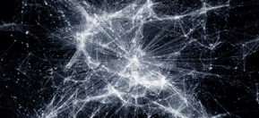
Three types of problem
Dynamics
Node dynamics
Network evolution
Features of networks
Structure & functionality
Network classification
Network alignment
Network similarity
Features of nodes
Node metrics
Node centrality
Ranking nodes
Link predictions

Slide 4
Problems
Human heuristics v.s. AI
Manuel feature engineering
Human designed models
Limitations
Hard to Scale
Hard to incorporate big data
Case by case

Slide 5
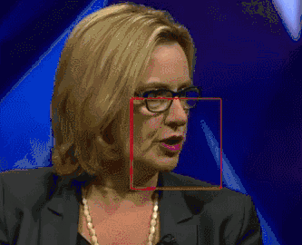
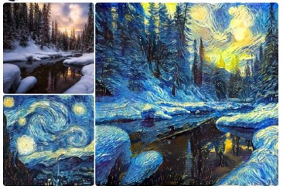
Triumphs of Deep Learning

Slide 6
Random Walk based Network Representation
Vectors for Nodes
N₁
0
Applications:
Node classification
Link prediction
Community detection
Centrality measure
….
N₂
0.1
N₃
0.5
N₄
0
N₅
0
N₆
0.2
N₇
0
N₈
0
N₉
0
N₁₀
0.2

Slide 7
Graph Network
Graph Neural Network(Scarselli et al., 2009)
Graph Convolutional Network(Kipf et al., 2017)
Graph Attention Network(Velicˇkovic ́ et al 2018)
Graph SAGE(Hamilton et al, 2017)
…
https://arxiv.org/abs/1806.01261

Slide 8
What is graph network?
https://arxiv.org/abs/1806.01261

Slide 9
Graph Module Computation
https://arxiv.org/abs/1806.01261

Slide 10
Three types of problem
Dynamics
Node dynamics
Network evolution
Features of networks
Structure & functionality
Network classification
Network alignment
Network similarity
Features of nodes
Node metrics
Node centrality
Ranking nodes
Link predictions

Slide 11
Link Prediction
Harder than node classifications
More fundamental
Without Node Labels
Generative Model

Slide 12
Framework
Graph Attention Model
Node Vectors
Network
N₁
N₂
N₃
N₄
N₅
N₆
N₇
N₈
N₉
N₁₀

Slide 13
Framework
Graph Attention Model
Node Vectors
Network
N₁
N₂
Link Probability
N₃
N₄
Logistic
N₅
N₆
N₇
N₈
N₉
N₁₀

Slide 14
Graph Attention Network
P.Velicˇkovic ́ et al.: Graph Attention Network, ICLR2018

Slide 15
Graph Attention Network
P.Velicˇkovic ́ et al.: Graph Attention Network, ICLR2018

Slide 16
Framework
Graph Attention Model
Node Vectors
Network
N₁
N₂
Link Probability
N₃
N₄
Logistic
N₅
N₆
N₇
N₈
N₉
N₁₀
Backward

Slide 17
Framework
Graph Attention Model
Node Vectors
Network
Attentional weights matrix
N₁
N₂
Link Probability
N₃
N₄
Logistic
N₅
N₆
N₇
N₈
N₉
N₁
N₁₀
N₂
N₃
N₄
N₅
N₆
Node Vectors
N₇
N₈
N₉
N₁₀

Slide 18
Deep Linker
Unpublished

Slide 19
Accuracy
Acc/auc | Cora | Citeseer | PUBmed | VC network
GAT | 0.79/0.88 | NA | NA | 0.53/0.71
DeepLinker | 0.88 / 0.95 | 0.89/0.93 | 0.9/0.97 | 0.85 / 0.94
SAGE | 0.83/0.896 | 0.857/0.925 | 0.886/0.964 | 0.812/0.878
Node2vec | 0.815 / 0.92 | 0.845 / 0.890 | 0.812/0.945 | 0.774 / 0.872
LINE | 0.69 / 0.76 | 0.67 / 0.73 | 0.660/0.723 | 0.787 / 0.843
RA(Resource Allocation) | 0.41 / 0.75 | 0.32 / 0.73 | 0.31/0.69 | 0.33 / 0.76
Unpublished

Slide 20
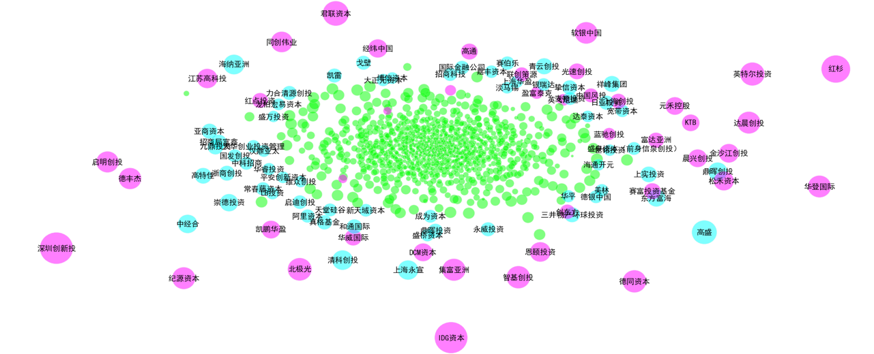
Byproduct I: Attention Weights Matrix
Unpublished

Slide 21
Byproduct I: Attention Weights Matrix
CB Insights & China Daily
Rank | Name
1 | 深圳创新投
2 | IDG资本
3 | 红杉
4 | 君联资本
5 | 高盛
6 | 英特尔投资
7 | 北极光
8 | 德同资本
9 | 集富亚洲
10 | 达晨创投
11 | 纪源资本
12 | 华登国际
13 | 软银中国
14 | 德丰杰
https://www.nanalyze.com/2018/01/best-chinese-venture-capital-firms/
Unpublished

Slide 22
Byproduct I: Attention Weights Matrix
Unpublished

Slide 23
Byproduct II: Node Vectors
The clusters of the DeepLinker’s representations are clearly defined with a Silhouette score of 0.38 compared with 0.09 in node2vec and 0.00 in raw features. The NMI value of DeepLinker is 0.44 compared with 0.41 in node2vec vectors and 0.13 in raw features

Slide 24
Three types of problem
Dynamics
Node dynamics
Network evolution
Features of networks
Structure & functionality
Network classification
Network alignment
Network similarity
Features of nodes
Node metrics
Node centrality
Ranking nodes
Link predictions

Slide 25
Learning Structure and Dynamics
张章
赵诣
刘晶
陶如意
王硕
张江
Accepted by journal of applied network science

Slide 26
Architecture
https://arxiv.org/abs/1812.11482

Slide 27
Network Generator
$$\left(\begin{matrix}α_{11} & ⋯ & α_{1N} \\ ⋮ & α_{ij} & ⋮ \\ α_{N1} & ⋯ & α_{NN}\end{matrix}\right)$$
Gumbel Softmax
https://arxiv.org/abs/1812.11482

Slide 28
What is Gumbel Softmax?
$$f\left(z\right)=f\left(y\right)$$
$$y=softmax\left(\log{P_{θ}\left(Y\right)}+g\right)=\frac{exp⁡(\frac{\log{{pθ}^{i}}+g^{i}}{τ})}{\sum_{i}{exp⁡(\frac{\log{{pθ}^{i}}+g^{i}}{τ})}}$$
$Z$ is a categorical variable (1,2,…,N) with probability
$$P_{θ}\left(Y\right)=\left({pθ}^{1},{pθ}^{2},…,{pθ}^{n}\right)$$
$g=\left(g^{1},g^{2},…,g^{n}\right)$ are iid random number with gumbel distribution
ICLR2017: https://arxiv.org/pdf/1611.01144.pdf, https://arxiv.org/pdf/1611.01144.pdf

Slide 29
Graph Network
https://arxiv.org/abs/1812.11482

Slide 30
A Simple Test
https://arxiv.org/abs/1812.11482

Slide 31
A Simple Test

Slide 32
Experimentes on Three Kinds of Dynamics f(x)
$$x_{i}\left(t+1\right)=\left(1−s\right)h\left(x_{i}\left(t\right)\right)+\frac{s}{D}\sum_{j≠i}{h\left(x_{j}\left(t\right)\right)}$$
$$\frac{dφ_{i}}{dt}=ω_{i}+k\sum_{j≠i}{A_{ij}sin⁡ (φ_{i}−φ_{j})}$$
$$h\left(x\right)=λx(1−x)$$

Slide 33
Experimental Results
Boolean Network
K=2,7,5,4 random graph; 5000 pairs of state transition sequences, 10 time steps
Coupled Map Lattice
33
random 4 graph; 5000 pairs of state transition sequences, 10 time steps
https://arxiv.org/abs/1812.11482

Slide 34
Experimental Results
Kuramoto Model
random 4 graph; 5000 pairs of state transition sequences, 10 time steps
34
https://arxiv.org/abs/1812.11482

Slide 35
Three types of problem
Dynamics
Node dynamics
Network evolution
Features of networks
Structure & functionality
Network classification
Network alignment
Network similarity
Features of nodes
Node metrics
Node centrality
Ranking nodes
Link predictions

Slide 36
Graph Classification
Long lived
Industrial
Dead
Agricultrual

Slide 37
Complex Network Classifier
Original Network
Network Representation
Rasterized Image
Class 1
Class 2
2 Conv, 2 Pool CNN
https://arxiv.org/pdf/1802.00539.pdf

Slide 38
Graph Classification
NCI1: bioinformatics dataset, Node: chemichal compounds, Link: reaction, Label: suppress/inhibit
COLLAB: collaboration, Node: person, Link: collaboration, Label: fields
RE_*: reddit discussion forum, Node: user, Link: responds, Label: community
https://arxiv.org/pdf/1802.00539.pdf

Slide 39
WS model v.s. BA model
Network Representation
Rasterized Image
BA Model
WS Model
2 Conv, 2 Pool CNN

Slide 40
Learned Filters
BA model
WS model

Slide 41
Classify WS with different p
We mix two WS networks with different p
Each item is a combination of two ps
It is distinguishable for p < 0.5
There is a sharp increase of error rates for p>0.5
WS networks are indiscriminate with random networks

Slide 42
Conclusion & Perspective
Complex Networks
Node feature discovery
Network Dynamics
Network overall structure and functionality
Graph Networks
Learning node features
Learning network structures
Graph classification
Perspectives
Automatic feature discovery
Automatic modelling

